Slide 1
University of Missouri System
UMKC Faculty Senate
Finance & Budget Update
Brian Burnett, PhD
Vice President for Finance & CFO
February 16, 2016

Slide 2
Agenda
Higher Education Funding Overview - Missouri
FY16 Operating Budget – Update & latest news
FY17 Operating Request for State Appropriations
FY17 Capital Request for State Appropriations
Internal Audit & Consulting Services Overview
Retiree insurance imperative and information

Slide 3
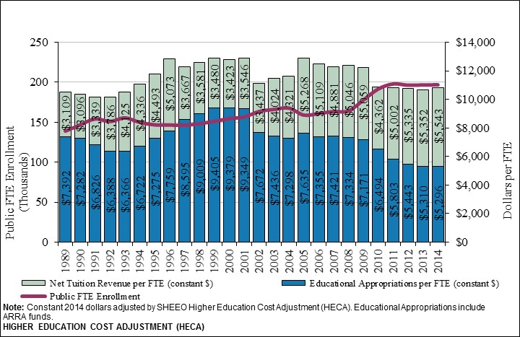
Public FTE Enrollment, Appropriations, & Tuition per FTE, MO

Slide 4
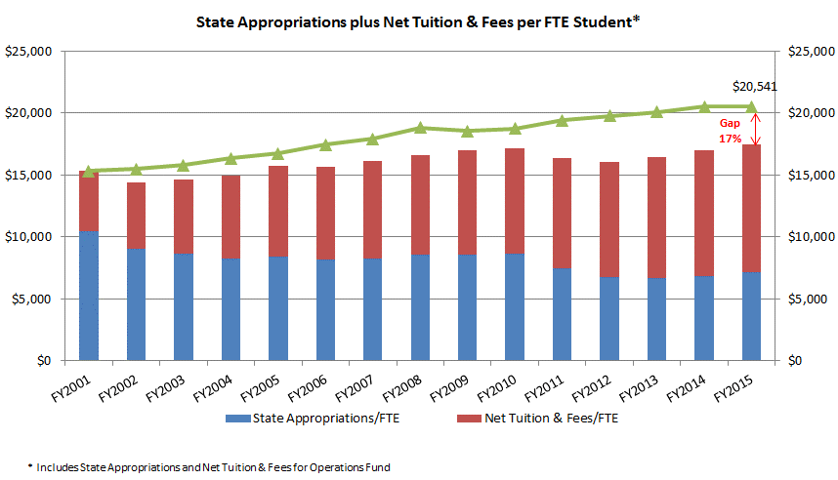
UM Per Student Revenue Decline since FY2001

Slide 5
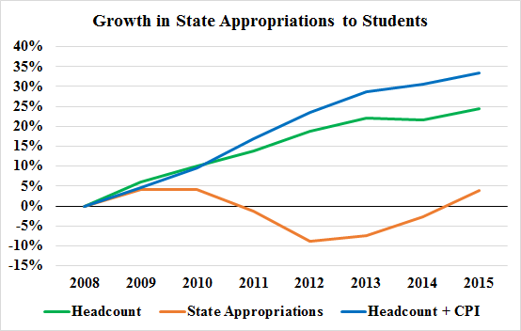
Percentage Growth in State Appropriations per Student, University of Missouri

Slide 6
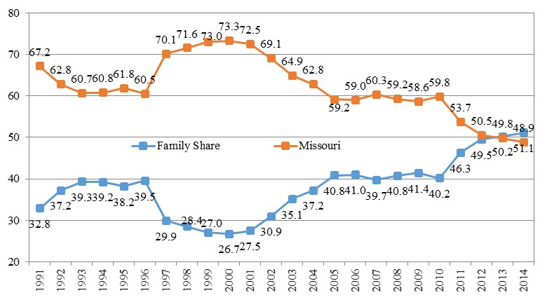
Family Share of Higher Education Operating Revenues, Missouri
SB389

Slide 7
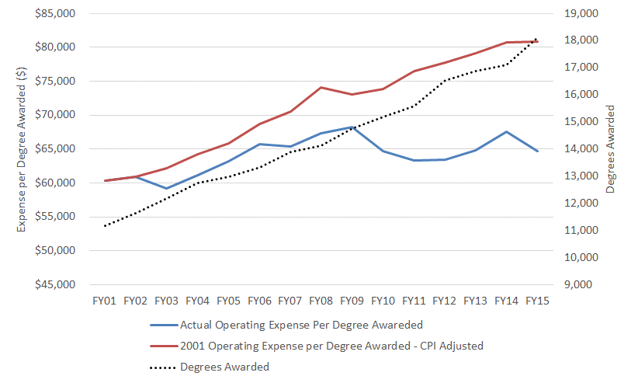
Reduction in Expense per Degree

Slide 8
UM System Peers
Michigan
Illinois
Minnesota
Nebraska
Tennessee
Colorado
UM System
Texas A&M
Arkansas

Slide 9
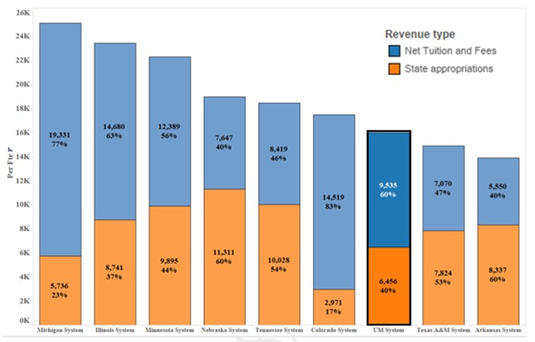
State Appropriations plus Net Tuition per FTE
Peer Systems

Slide 10
Operation Planning Overview
Strategic Funds Request
Campus Financial Plan
Strategic Plan
Tuition & Fee Rate Requests
Campus Operating Budget
Campus Operating Budget
Board Approval
UM System Review

Slide 11
Annual Budget Cycle - Updated
July | Board approved FY17 State Operating and Capital Appropriation Requests
December | Budget assumptions developed for FY17 tuition decisions Board reviews preliminary tuition and fee info
February | Budget assumptions are refined – CPI at 0.7% Board typically approves FY17 tuition and fees-DELAYED Board approves FY17 housing and dining rates - COMPLETE
April | Budget assumptions continue to be refined Board reviewes preliminary operations budget assumptions
April/May | Detailed budgets are developed – Final tuition and fees set
June | Detailed budgets are finalized Board approves FY17 Operating Budgets

Slide 12
FY2016 $3.1 billion Budget by Revenue Source
Dollars in Millions

Slide 13
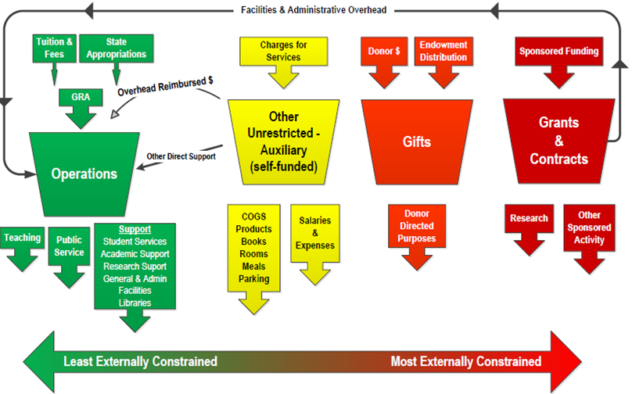
Color of Money Matters

Slide 14
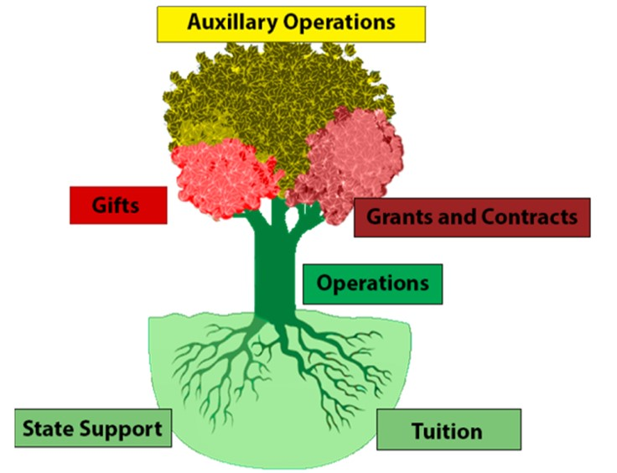
University Funding Tree

Slide 15
FY2016 $3 billion Current Fund Budget by Type
Dollars in Millions

Slide 16
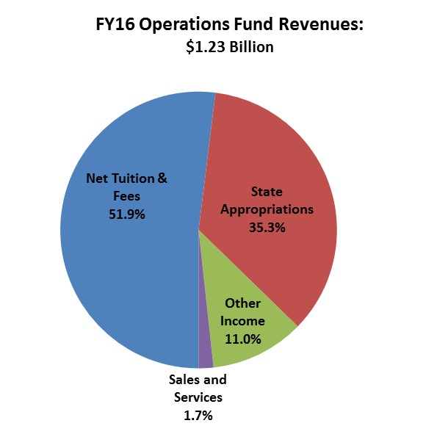
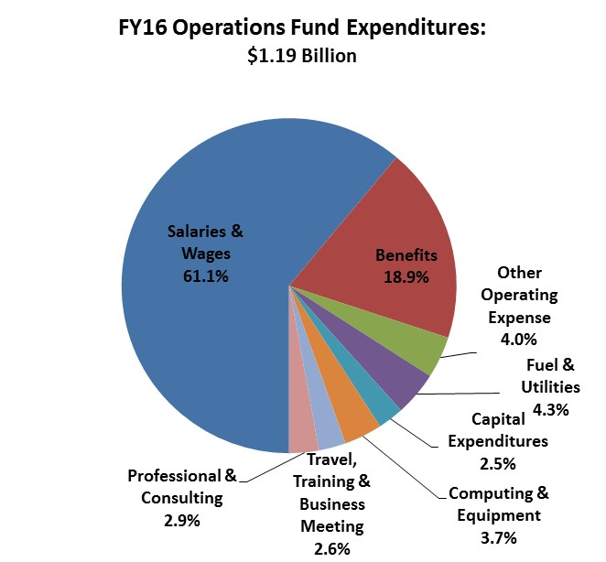
Compensation is 80% of Operations Expenses

Slide 17
FY17 Operating Request Components-$497.3M
Core Operations $447.3 M
New Requests $31.9 M
Other Curator Programs $7.7 M
Legislative Requirements $10.4 M

Slide 18
Funding for Core Operations $447.3 M
$ Millions

Slide 19
New Requests $31.9 M
* Includes $1 million Missouri S&T and MSU cooperative mechanical engineer program. Other STEM programs with specific deliverables are being defined by MU, UMKC and UMSL.
$ Millions

Slide 20
FY17 Capital Request Highlights
Maintenance and Repair Priorities
  $16.8 million for McKee Hall at MU
  $16.3 million for Spencer Chemistry and Biological Sciences at UMKC
  $37.9 million for Schrenk Hall at Missouri S&T
  $24.6 million for Stadler Hall at UMSL.
Public-Private 50/50 Projects
  $12.9 million for the School of Music at MU
  $3 million for the Butler-Carlton Hall Advanced Construction Materials Lab-Expansion at Missouri S&T
  $3 million for the Center for Regenerative Orthopaedics at MU
  $1.5 million for a Teaching and Research Winery at MU.

Slide 21
Internal Audit: A More Efficient and Effective Approach
Moved to an “insourced” model that will provide:
Increased coverage (2-3 times)
Access to internal consulting
Increased partnership between audit and management
Increased presence on all four campuses
Develop training ground for University staff
Recruit our business students through a robust internship program

Slide 22
Internal Audit and Consulting Services Mission
To provide the Board of Curators, President, Campus Chancellors, and Senior Leaders independent and objective assurance and consulting services designed to add value and to improve operations.
Internal audit brings a systematic and disciplined approach to evaluating and improving the effectiveness and efficiency of risk management, control and governance processes.

Slide 23
Retiree Insurance Issue
Changes in health care landscape (ACA) and increasing costs force employers to re-examine offerings for retirees
Negative effect on UM system credit rating
GASB standards changing to force recording of liability on UM balance sheet
Increasing costs unsustainable in budget
Align with most comparable peer systems

Slide 24
Why changes are needed:
Growth in salary and benefit costs
UM growth in salary and benefit costs, as compared to the growth in revenue
Benefits
Revenue
Salary

Slide 25
Unsustainable Growth
The following graph shows growth in the unfunded liability if no change is made:
$6.2 billion

Slide 26
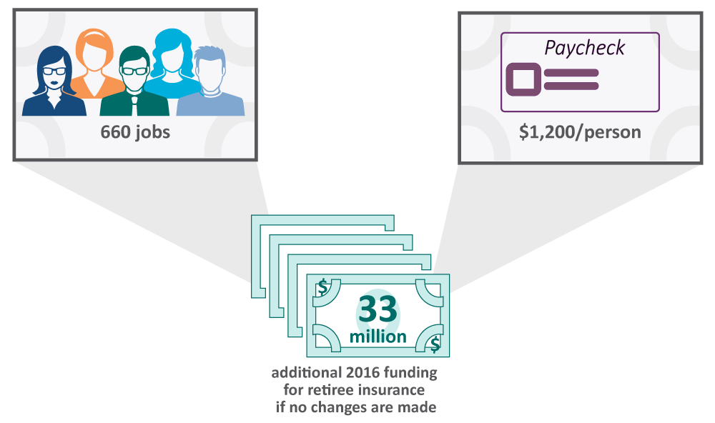
Why changes are needed:
Effects if we don’t make a change
UM has an $808 million liability this year, which will only grow over time
Paying this year’s bill on the liability would require an extra $33 million and increase 5-6% annually

Slide 27
Total Rewards Advisory Committee
Key Recommendations
Preserve benefit for current retirees
Eliminate benefit for new hires
Reward long-serving employees with an affordable option
Eliminate the growing liability and unsustainable liability growth
Keep benefit rate constant

Slide 28
Proposed solution diminishes Liability
The following graph shows the projected OPEB liability under the TRAC proposal:
$333 million

Slide 29
Questions?

